Slide 1
Cal Marples
21st February 2025

Slide 2
A minimal vertex model explains how the amnioserosa avoids fluidization during Drosophila dorsal closure
Indrajit Tah, Daniel Haertter, Janice M. Crawford, Daniel P. Kiehart,
Christoph F. Schmidt, Andrea J. Liu
Proceedings of the National Academy of Sciences Vol. 122, No. 1
DOI: 10.1073/pnas.2322732121

Slide 3
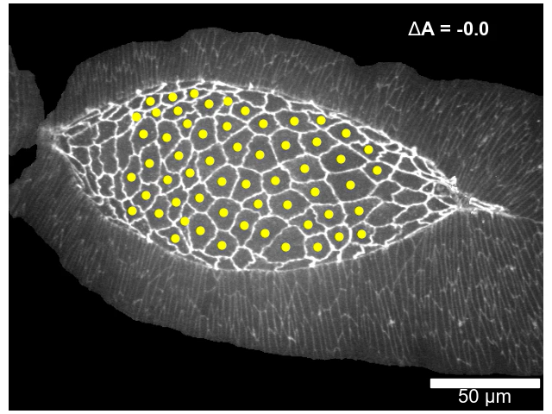
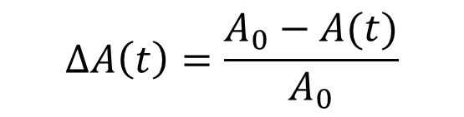
Background
Dorsal closure during embryogenesis of the Drosophila
The amnioserosa tissue shrinks over time:
The tissue remains rigid! Why?
$$ΔA\left(t\right)=\frac{A_{0}−A(t)}{A_{0}}$$

Slide 4
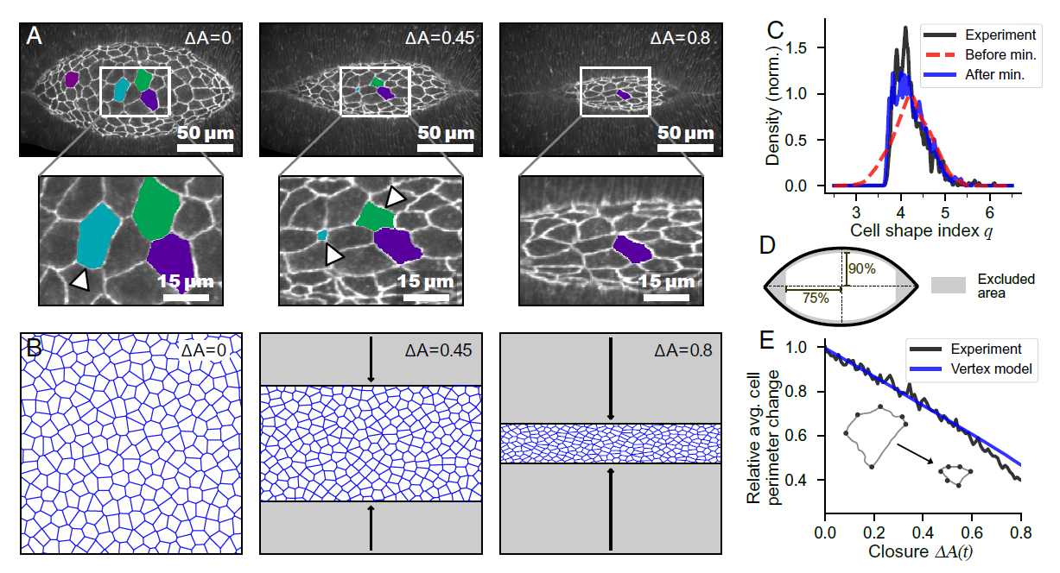
Modelling and Experimental Analysis

Slide 5
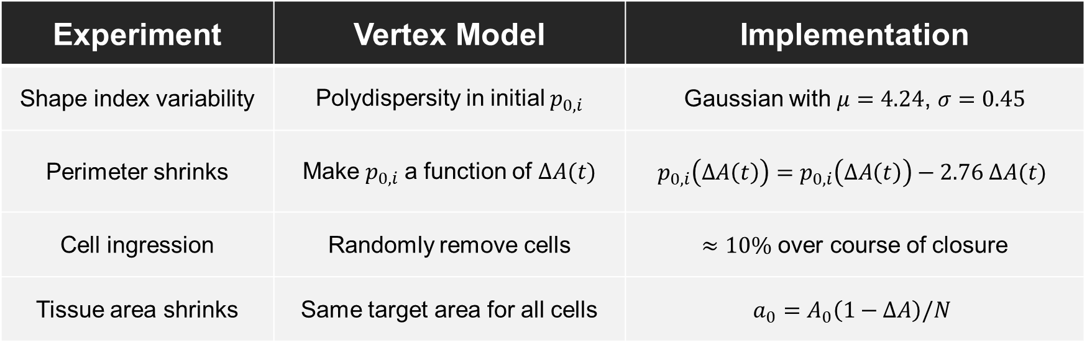
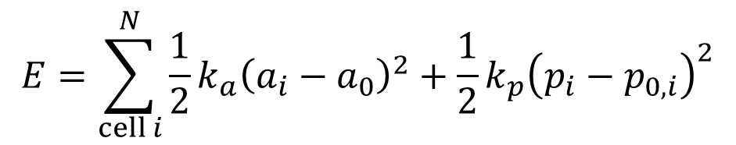
Extensions to the Vertex Model
$$E=\sum_{cell i}^{N}{\frac{1}{2}k_{a}{\left(a_{i}−a_{0}\right)}^{2}+\frac{1}{2}k_{p}{\left(p_{i}−p_{0,i}\right)}^{2}}$$
Mechanical energy:
Experiment | Vertex Model | Implementation
Shape index variability | Polydispersity in initial $p_{0,i}$ | Gaussian with $μ=4.24$, $σ=0.45$
Perimeter shrinks | Make $p_{0,i}$ a function of $ΔA(t)$ | $$p_{0,i}\left(ΔA\left(t\right)\right)=p_{0,i}\left(ΔA\left(t\right)\right)−2.76 ΔA(t)$$
Cell ingression | Randomly remove cells | $≈10\%$ over course of closure
Tissue area shrinks | Same target area for all cells | $$a_{0}=A_{0}\left(1−ΔA\right)/N$$

Slide 6
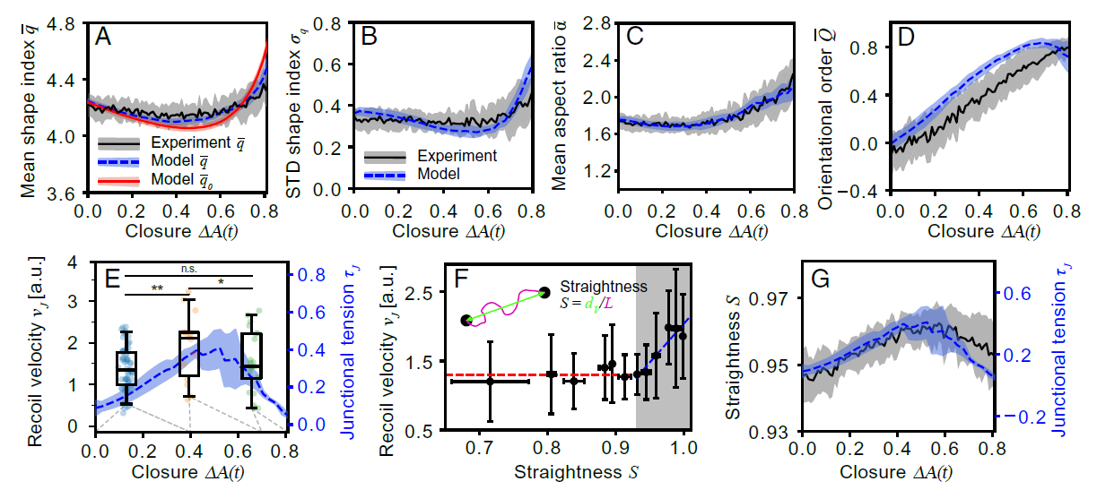
Shape Analysis and Measuring Tension

Slide 7
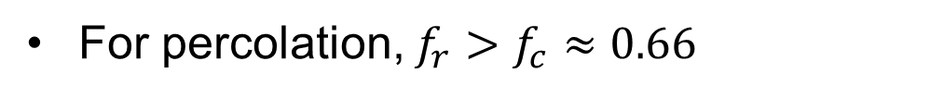
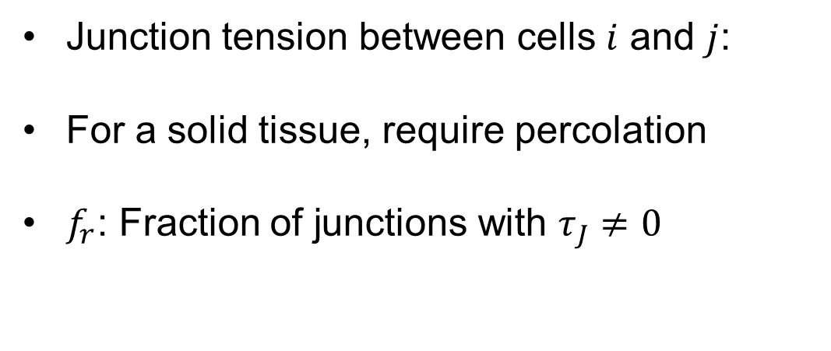
Junction Tension and Percolation
Junction tension between cells $i$ and $j$:
For a solid tissue, require percolation
$f_{r}$: Fraction of junctions with $τ_{J}≠0$
$$τ_{J}=k_{p}\left(p_{i}−p_{0,i}\right)+k_{p}\left(p_{j}−p_{0,j}\right)$$
For percolation, $f_{r}>f_{c}≈0.66$

Slide 8
Why Does the Tissue Remain Solid?
To maintain rigidity during closure, cell perimeters must shrink over time!

Slide 9
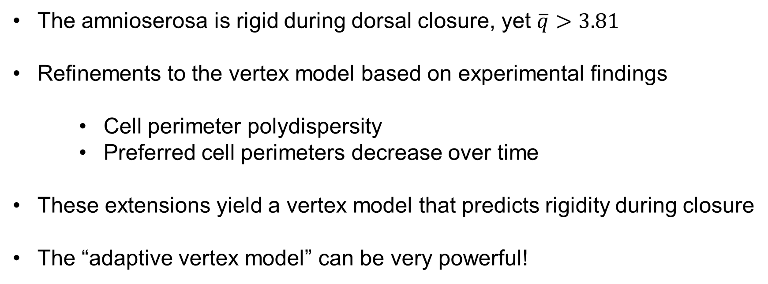
Summary
The amnioserosa is rigid during dorsal closure, yet $\overline{q}>3.81$
Refinements to the vertex model based on experimental findings
Cell perimeter polydispersity
Preferred cell perimeters decrease over time
These extensions yield a vertex model that predicts rigidity during closure
The “adaptive vertex model” can be very powerful!

Slide 10
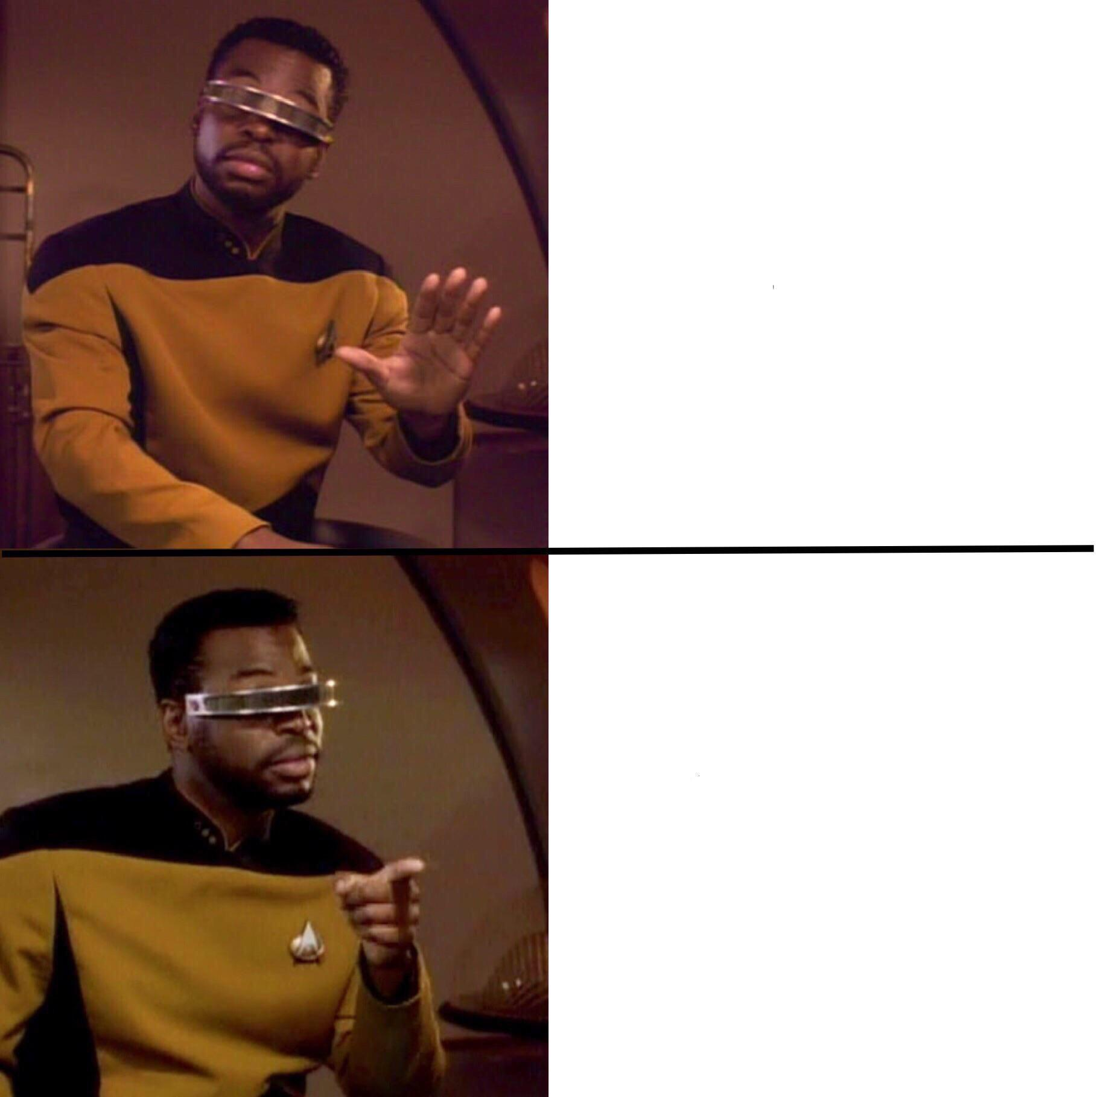
Keeping all parameters fixed
Letting parameters vary in both time and space

